Slide 1

UK RETAIL STORE SALES DATA ANALYSIS
PRESENTED BY
MARILYN SEDEM NAAYO

Slide 2

INTRODUCTION
Notes:
Project Overview
Project Objectives

Slide 3
OBJECTIVE
Provide actionable insights for increasing sales at the UK Retail Store through analysis of its historical sales data
Notes:
Project Overview
Project Objectives

Slide 4
DATA OVERVIEW
Client
Data
Leading Retail store with outlets in UK and 37 other countries.
Sales data including customer ID, dates, Item description, quantity, price.
Duration
Data spans one year(Dec, 2010 – Dec, 2011)

Slide 5
BUSINESS UNDERSTANDING
Notes:
Project Overview
Project Objectives

Slide 6
BUSINESS QUESTIONS
How many items are there?
What are the most purchased items?
What are the least purchased items?
How many customers are there?
Who are the top customers and what do they patronize?
On what days of the week are most sales made?
At what time of the day are the most sales made?

Slide 7
KEY BUSINESS INSIGHTS
Notes:
Project Overview
Project Objectives

Slide 8
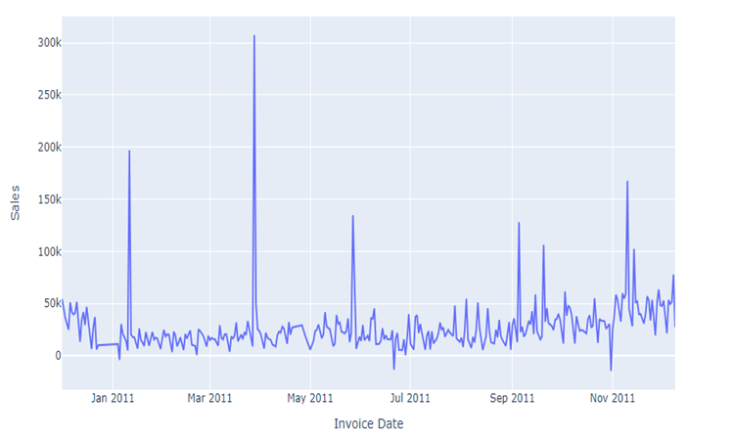
CURRENT BUSINESS STATISTICS
Total Sales
₤8.618M
Products
> 3804
Number of Customers
> 3,950
SALES TREND OVER DURATION

Slide 9
Average Sales over Time of Day

Slide 10
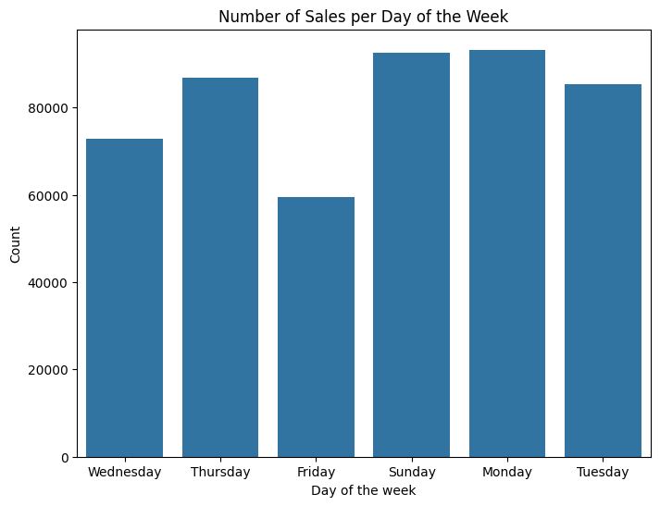
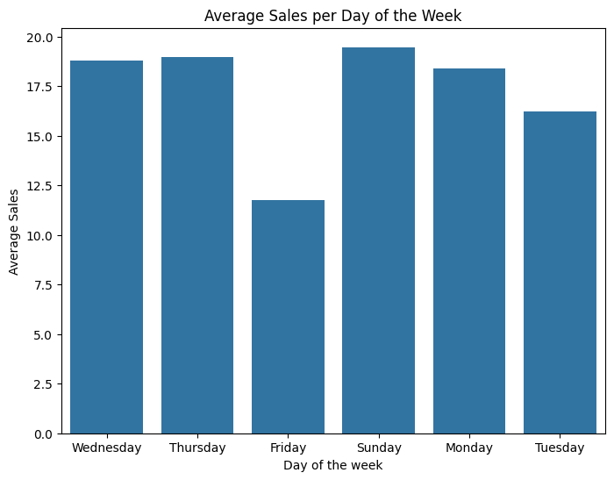
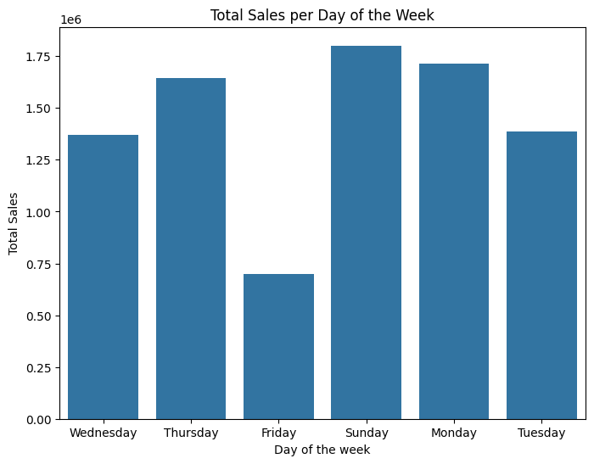
Sales by Day of the Week

Slide 11
Least Purchased Items
ITEM DESCRIPTIONS
BLOSSOM IMAGES SCRAP BOOK SET WRAP BLUE RUSSIAN FOLKART PINK/WHITE GLASS DEMI CHOKER SET 10 CARD CHRISTMAS STAMPS 16963 RUBY GLASS CLUSTER NECKLACE LASER CUT MULTI STRAND NECKLACE WRAP A PRETTY THANK YOU WRAP PINK FLOCK CREAM SWEETHEART TRAYS LETTER "U" BLING KEY RING
Notes:
Marketing Campaigns: Launch targeted marketing campaigns to promote the least bought products. This could include social media advertising, email marketing, or collaborations with influencers.
Discounts and Promotions: Offer discounts or promotions on the least bought products to incentivize purchases. This could be in the form of percentage discounts, buy-one-get-one offers, or limited-time sales.
Bundling: Bundle the least bought products with more popular items to increase their visibility and encourage customers to try them out. This can create value for customers and increase overall sales.
Improving Product Visibility: Ensure that the least bought products are prominently displayed

Slide 12
Most Purchased Items
ITEM DESCRIPTIONS
WHITE HANGING HEART T-LIGHT HOLDER JUMBO BAG RED RETROSPOT REGENCY CAKESTAND 3 TIER PARTY BUNTING LUNCH BAG RED RETROSPOT ASSORTED COLOUR BIRD ORNAMENT POPCORN HOLDER SET OF 3 CAKE TINS PANTRY DESIGN LUNCH BAG BLACK SKULL NATURAL SLATE HEART CHALKBOARD LUNCH BAG SUKI DESIGN HEART OF WICKER SMALL JUMBO BAG PINK POLKADOT PACK OF 72 RETROSPOT CAKE CASES JUMBO BAG VINTAGE DOILY
Notes:
Marketing Campaigns: Launch targeted marketing campaigns to promote the least bought products. This could include social media advertising, email marketing, or collaborations with influencers.
Discounts and Promotions: Offer discounts or promotions on the least bought products to incentivize purchases. This could be in the form of percentage discounts, buy-one-get-one offers, or limited-time sales.
Bundling: Bundle the least bought products with more popular items to increase their visibility and encourage customers to try them out. This can create value for customers and increase overall sales.
Improving Product Visibility: Ensure that the least bought products are prominently displayed

Slide 13
High Demand Items
ITEM DESCRIPTIONS
WHITE HANGING HEART T-LIGHT HOLDER PARTY BUNTING JUMBO BAG RED RETROSPOT PAPER CHAIN KIT 50'S CHRISTMAS ASSORTED COLOUR BIRD ORNAMENT POPCORN HOLDER RABBIT NIGHT LIGHT JUMBO BAG PINK POLKADOT JUMBO BAG VINTAGE DOILY VICTORIAN GLASS HANGING T-LIGHT

Slide 14
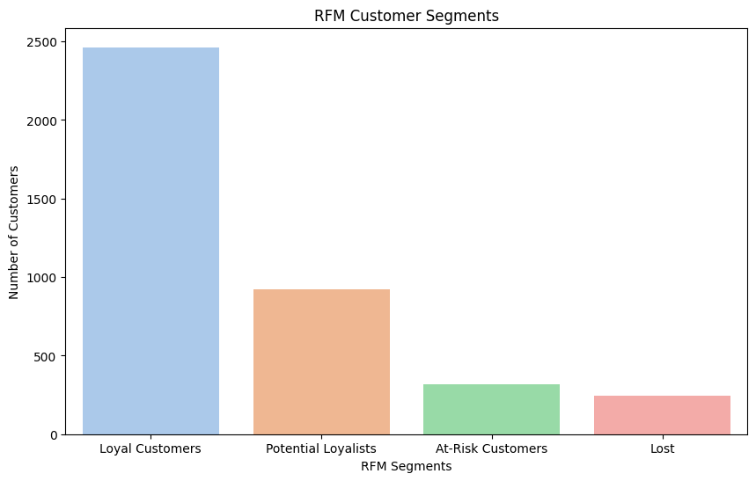
RFM CUSTOMER SEGMENTS
2,463
924
319
245

Slide 15
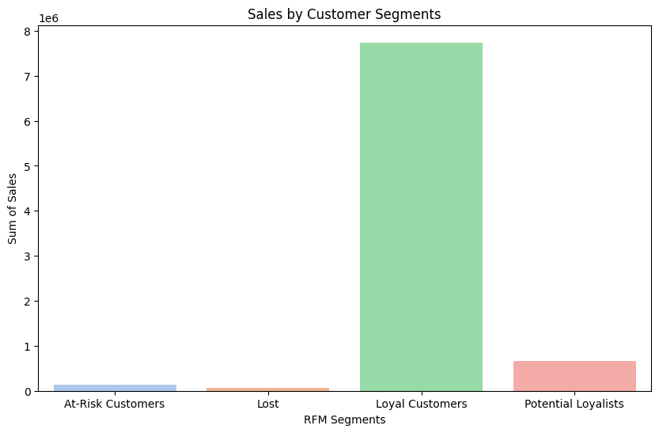
Sales by Segment
7.7m
664,142
142,734
73,289

Slide 16
RECOMMENDATIONS
Target the loyal customer and the potential loyalists segments by conducting further studies on what items are most patronized by these market segments and providing promotions on those.
Special promotions can be run on the more profitable items as a reward to loyal customers and potential loyalists for their frequency. This will increase their monetary value.
High Demand Items should be ordered ahead of time to maintain sales.
High value purchases can be rewarded with freebies of the less purchased items.
Sundays are the best day for sales as the store generally gets more patronage then
Introduce bundling of high selling products with low selling ones during sales.
Shelves can be optimized by also arranging less patronized items with high demand Items or high patronage items and keeping them on front shelves for increased visibility.
Conduct study on what causes items to be returned.
Provide data on profit made from each sale to allow analysis of the profitability of sales.
More data from past years should be provided to help predict future revenue.

Slide 17
THANK YOU

